Slide 1
Does the Success of an Attack Depend on the Type of Attack?
Lauren, Terrance, Jui-Ying and Yang

Slide 2
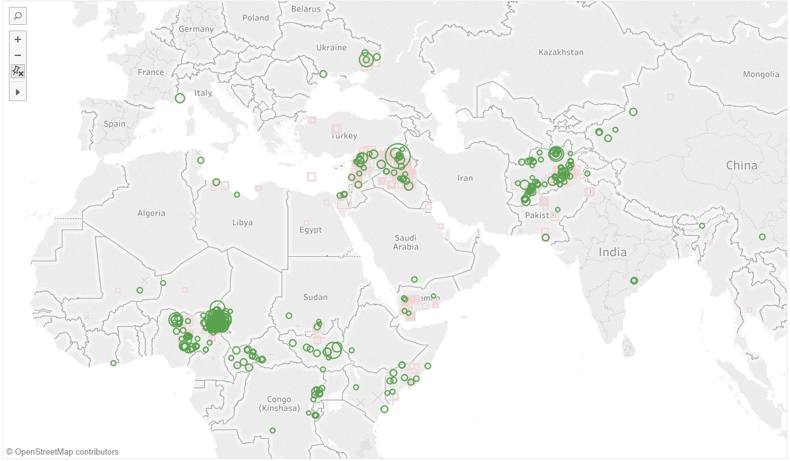
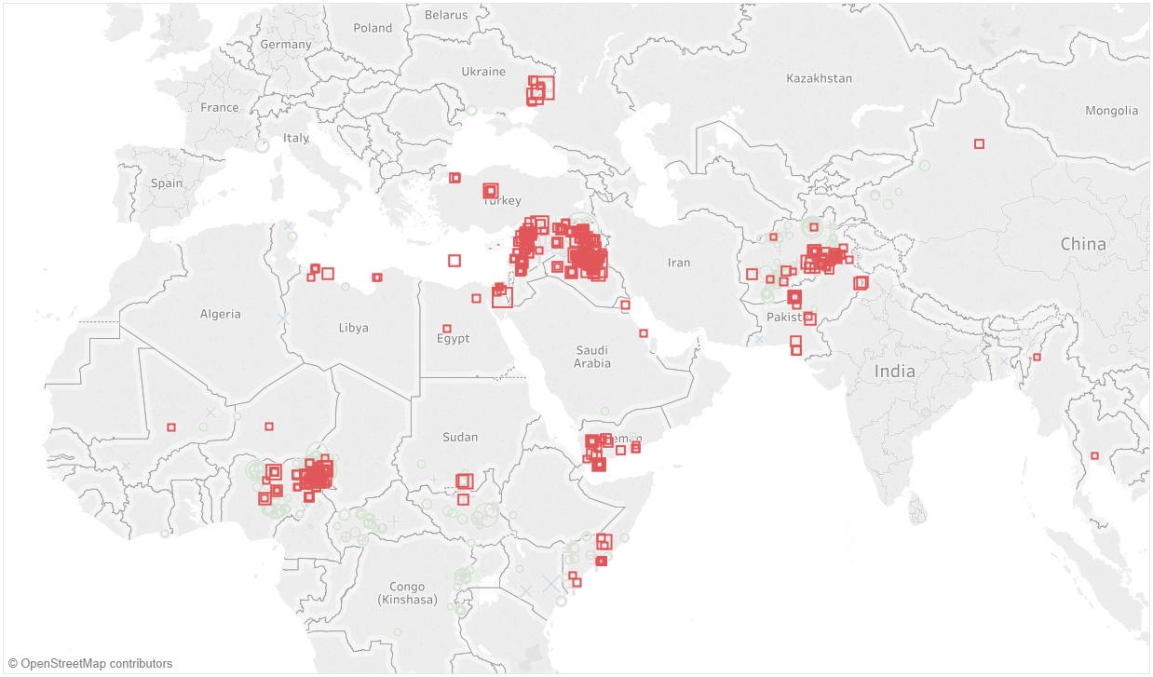
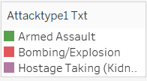
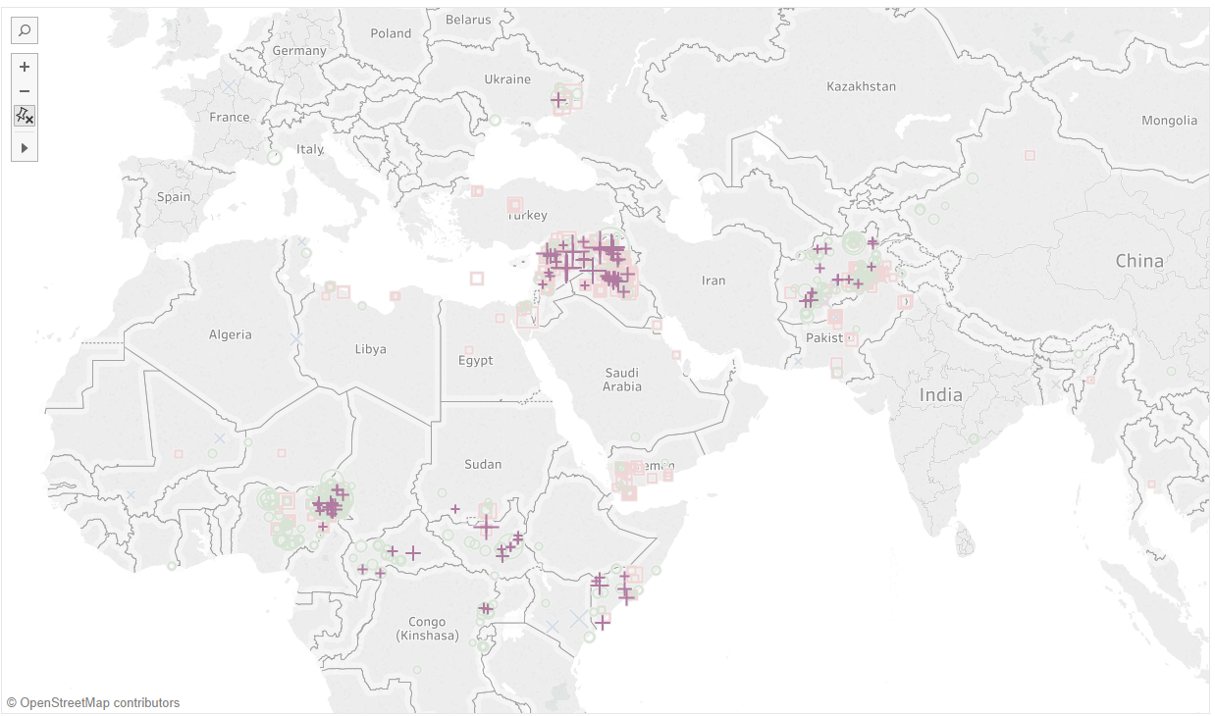
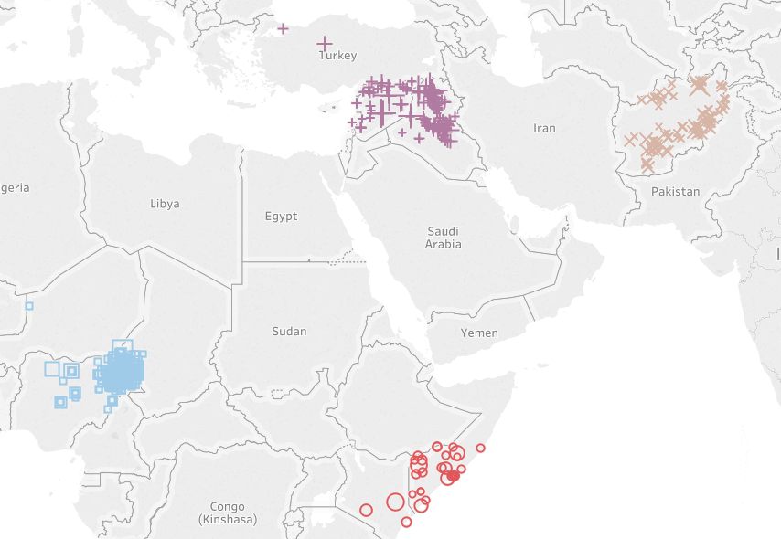
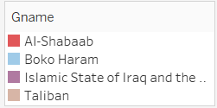
Most Common & Most Deadly Attack Methods
Syria/Iraq
Afghanistan
Chad/Nigeria
Kenya/Somalia
Notes:
Most common and deadliest attacks within this region, which has highest density of attacks
Attacks clustered into 4 main areas
Wanted to see if specific groups were operating in these areas, and found that each of the four most active terrorist groups were executing independently in the four areas with the most attacks
These groups were responsible for the most amounts of deaths using these types of attacks

Slide 3
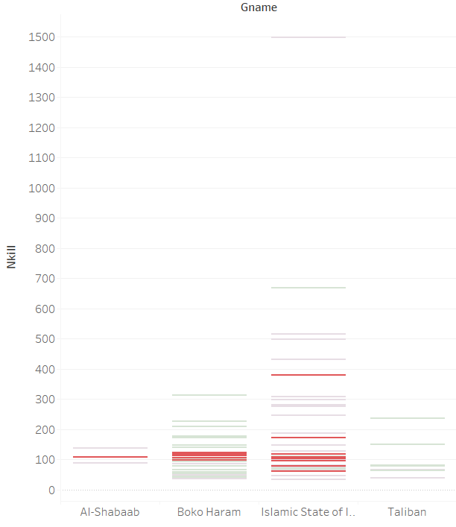
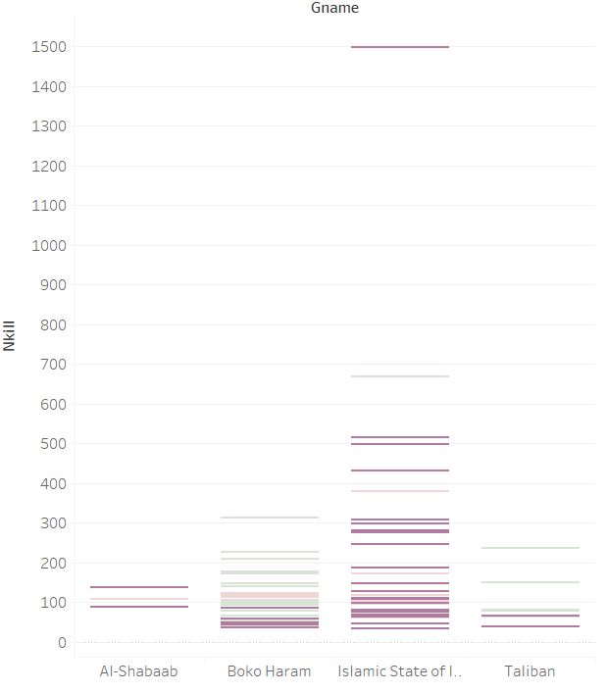
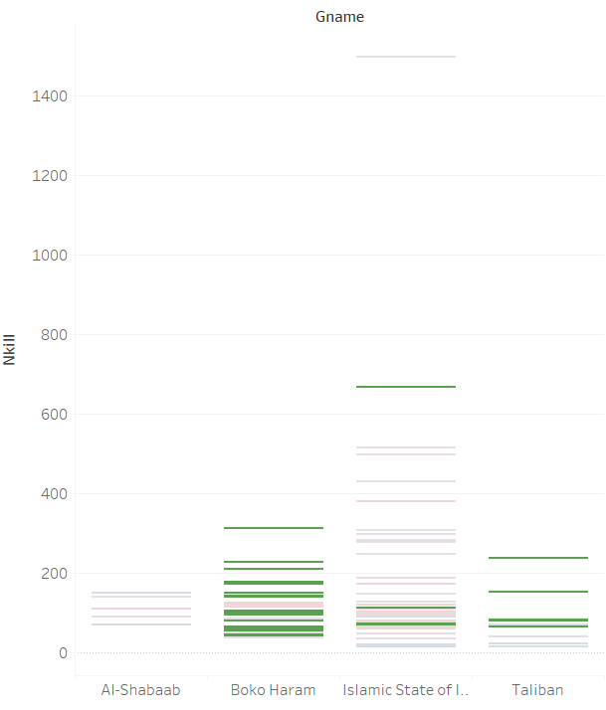
Preferred Methods and Relative Deadliness
Armed Assault
Explosives/Bombing
Hostage Taking
Notes:
Here we want to examine which group favored which tactics
Expected that all groups possibly use an even mixture of all attacks depending on what they wanted to accomplish, but we saw clear favorite methods amongst the groups
Armed Assault was favored by Boko Haram and the Taliban
Explosives and bombing methods were favored by ISIL and Boko Haram
Hostage taking was favored by ISIL and resulted in the most deaths

Slide 4
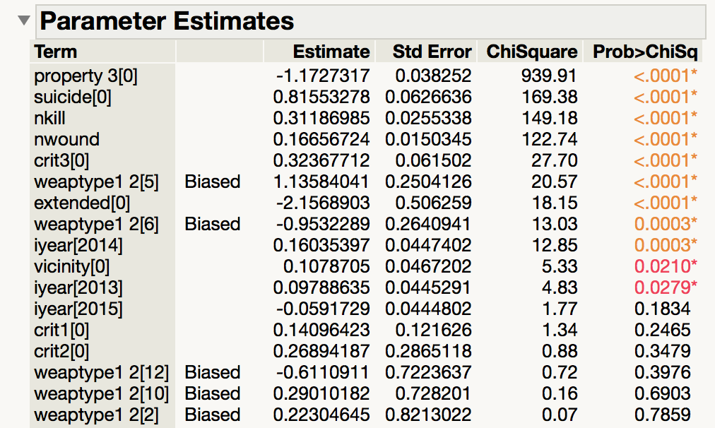
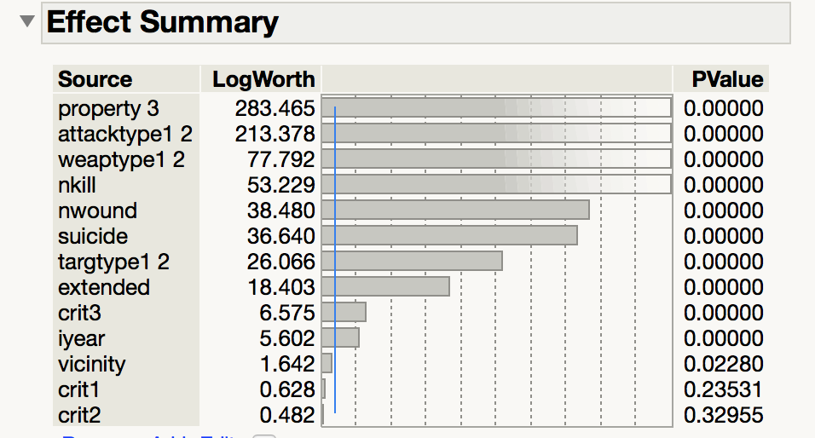
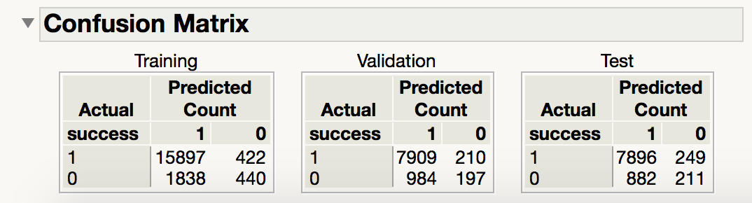
Logistic Regression Model on “Success Attack”
Training: 50%
Validation: 25%
Test: 25%
Sensitivity of validation: 97.41%
Sensitivity of test: 96.94%
Notes:
We also built a logistic regression model on “ Success” variable in order to predict for the probability of success in the future attack.
At first, we splitted dataset and created the validation and test dataset. After deleting unknown observations and ignore missing values, we applied a logistic regression model.
The top left figure shows the variables that contributed most to the probability of success. The variables are sorted by contribution percentage. The most significant predictor is the property variable.
Specific parameter estimate, positive and negative.
As a conclusion, we assume that the success of an attack does not only depends on the type of attack, but also on other important factors, like whether or not the property is damaged, types of weapon, etc.

